Slide 1

Introduction to Spatial Analysis and
Digital Soil Mapping
Dr. Marcos Angelini & Dr Luis Rodríguez-Lado

Slide 2
What is spatial analysis?
Spatial analysis is a broad term that encompasses a variety of techniques and processes used to analyze location-based data to identify patterns, relationships, and trends across geographical spaces.

Slide 3
Objectives of spatial analysis
Understanding environmental patterns and processes:
to identify and analyze spatial patterns
to understand natural processes
Environmental planning and management:
to effectively manage natural resources
to identify sites of interventions
Policy development and decision making:
to provide evidence-based insights to policymakers

Slide 4
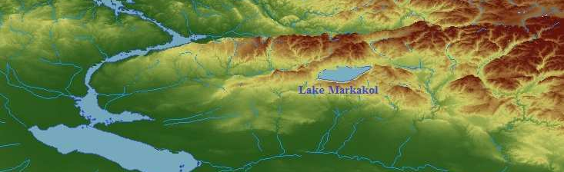
Spatial phenomena
Spatial phenomena can generally be thought of as either :
discrete objects with clear boundaries (e.g. river, road, town)
or as a continuous phenomenon that can be observed everywhere, but does not have natural boundaries (e.g. elevation, temperature, and air quality).
A lake is a discrete object:
it has clear boundaries
Elevation is a continuous phenomena: it exists in every point

Slide 5
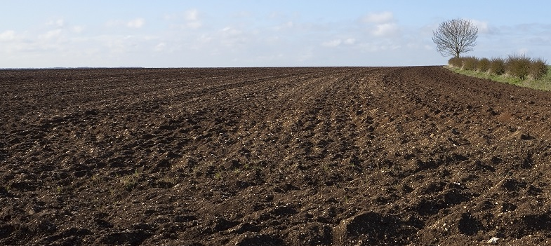
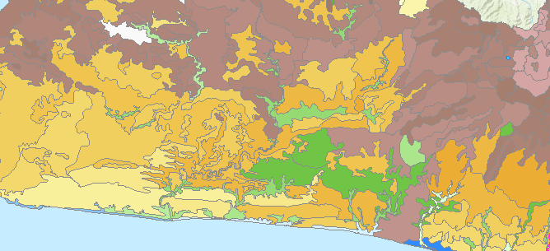
Spatial phenomena
Soil is a continuous phenomenon. It covers almost all land surface.
However we classify soils into discrete soil types that have boundaries

Slide 6
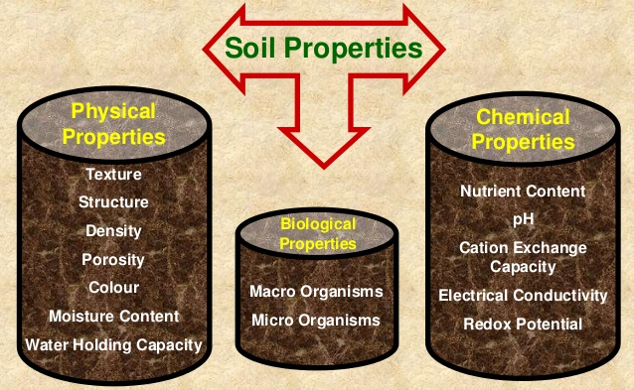
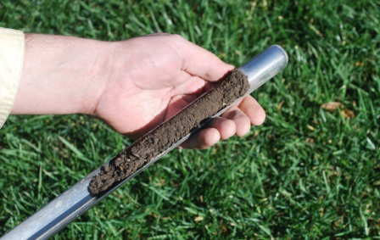
Spatial phenomena
Most of the soil properties are continuous. They exist in every point of the soil.
Soil measurements are discrete. We sample soil and measure soil properties in discrete locations.

Slide 7
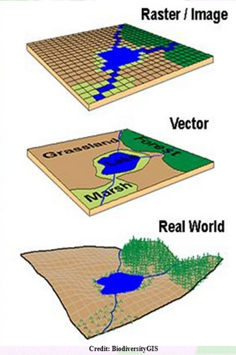
Spatial data structures
There are 2 ways to represent spatial data: Vector and Raster
Vector model:
Objects, represented as points, lines and polygons
Good for storing discrete data
Raster model:
Surface divided into a regular grid of cells (pixels)
Can be used both for storing discrete and continuous data

Slide 8
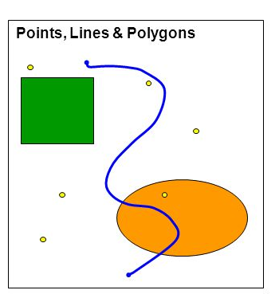
Vector data
Key characteristics of Vector data:
Discrete spatial objects: points, lines or polygons
Attribute table attached to spatial objects
Common Vector data formats: shapefile (.shp)
Advantages of Vector data:
Good for storing discrete data (e.g. points)
High geographic accuracy of points and boundaries
Disadvantages of Vector data:
Continuous data is poorly stored (needs classification)
Hard to make calculations with multiple layers

Slide 9
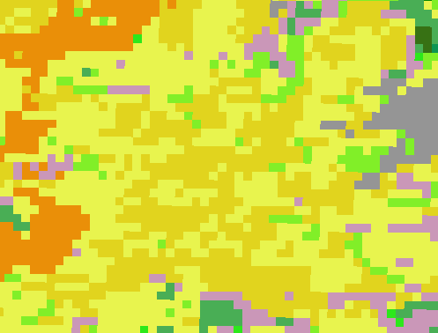
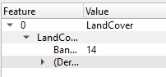
Discrete raster data (categorical)
Zoom-in to see that the image consists of pixels (raster cells);
Click on the image to see values;
There is no attribute table only single value in each raster cell
These values are not real numbers, but coded categories
You can see the meaning of each coded category in the legend, e.g:
14 - Rainfed croplands

Slide 10
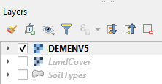
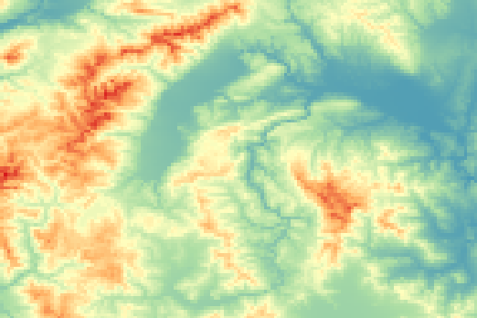
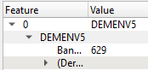
Continuous raster data
Zoom-out, switch off LandCover, and switch on DEMENV5 layer
This is a digital elevation model
Click on different parts of the map to see the values
Value of each cell represents real elevation (altitude) in meters above sea level.

Slide 11
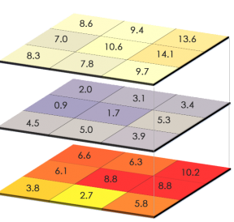
Raster data
Key characteristics of Raster data:
A regular grid of cells (pixels) with a value in each cell
Raster resolution defines cell size and accuracy
Higher resolution = smaller cell size = better quality
Common Raster data formats: GeoTiff (.tif, .tiff);
Advantages of Raster data:
Can store discrete data (categories) and continuous data (values)
Calculations with multiple rasters is quick and easy to perform
Disadvantages of Raster data:
Its accuracy depend on the scale. The physical space is not a grid,

Slide 12
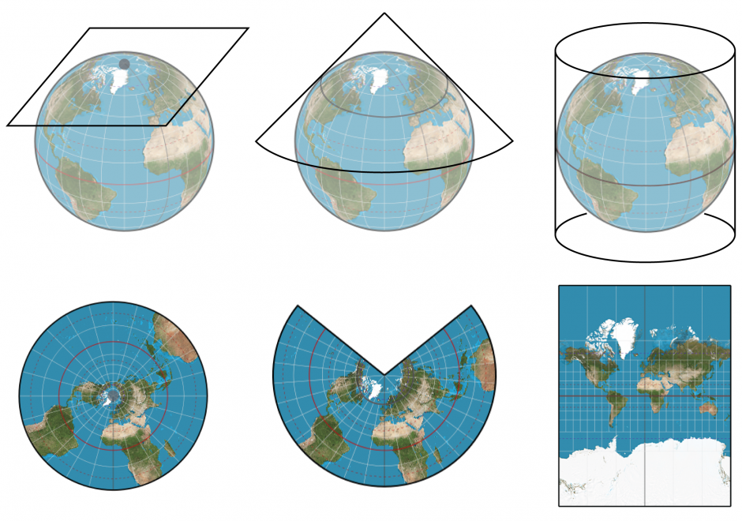
Map projections
All spatial data are displayed using a certain projection
All projections of a sphere on a plane cause surface distortions
Depending on the purpose of the map different map projections exist in order to preserve some properties

Slide 13
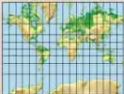
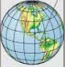
Coordinate Reference Systems (CRS)
Coordinate Reference System (CRS) is an essential property of spatial data: it defines, how coordinates of our data are stored.
2 types of CRS:
Geographic:
Coordinates are stored as latitude and longitude - in degrees
Good for storing data (independently of projection)
Cannot be used for spatial calculations (e.g. distance, area)
e.g. WGS 84 (EPSG:4326)
Projected:
Coordinates are stored according to a projection - in meters
Can be used for spatial calculations (e.g. distance, area)
Knowledge of the exact CRS is required to interpret the data
e.g. UTM zone 48S (EPSG:32748)
Information on EPSG codes: https://epsg.io/

Slide 14
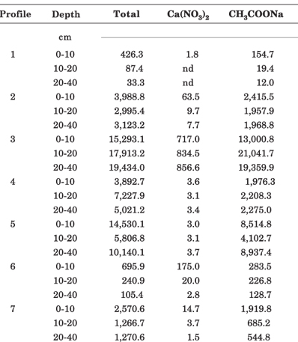
Soil observations
What about data of soil observations (soil profiles, surface sampling)?
Usually, data of soil observations are stored as a table (xlsx, csv)
When a table has coordinates (X, Y), it can be converted into Vector data type - Points.

Slide 15
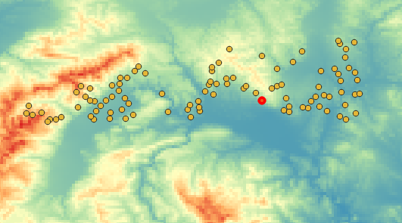
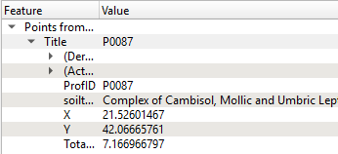
Point data (soil observations)
You can explore a new Vector data layer with point observations;
You can select points and see the attributes

Slide 16
Soil properties data
We have:
Discrete soil observations as point data in sampling locations
We need:
Continuous estimation of soil properties in every point of the land surface
Task of the Digital Mapping of Soil Properties:
To predict continuous soil properties in unvisited locations based on discrete measurements of soil sampling.

Slide 17
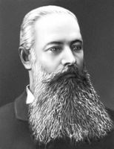


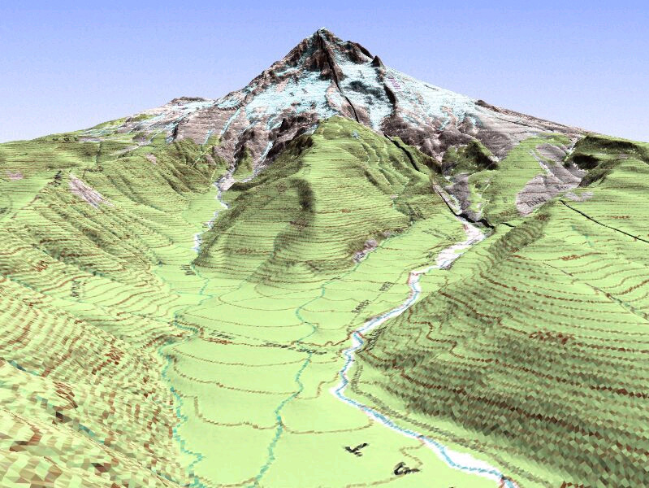


Drivers of soil formation
V. Dokuchaev (1883):
Genesis and evolution of soils is the result of the interaction of a number of environmental parameters:
Climate
Organisms
Parent Material
Relief
Time

Slide 18
Drivers of soil formation
H. JENNY (1941):
Conceptualization of soil as an state equation of soil formation.
Soil and soil properties are a function of a number of environmental parameters named soil forming factors:
S = ƒ(cl, o, r, p, t)
CLORPT MODEL
climate
organisms
relief
parent material
time

Slide 19
Digital Soil Mapping (DSM)
Definition of Digital Soil Mapping (DSM)
The creation and population of spatial soil information systems by numerical models inferring the spatial and temporal variations of soil types and soil properties from soil observations and knowledge and from related environmental variables (Lagacherie and McBratney, 2007).
McBratney et al., 2003: Conceptualization of forming factors. Soil and soil properties are a function of a number of environmental parameters named soil forming factors:
S = ƒ(s, c, o, r, p, a, n)+ ε
SCORPAN MODEL
soil attribute to predict
soil
properties
climate
organisms
relief
parent
material
age
location
function residuals (errors)

Slide 20
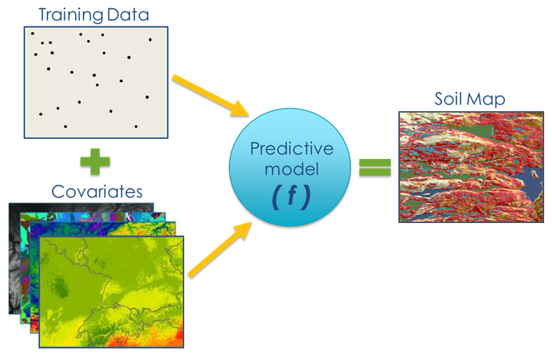
Digital Soil Mapping Workflow
Source: USDA

Slide 21
Digital Soil Mapping Workflow
Steps to Map Soil Properties with DSM approach:
Prepare soil observations (soil profile data);
Prepare environmental covariates (raster layers);
Fit the prediction model using a target soil property (e.g. SOC) as a dependent variable and the covariates as predictors;
Linear modelling;
Geostatistical modelling;
Machine learning;
Map the soil property using the prediction model;
Assess the quality and uncertainty of the map.

Slide 22





